Slide 1
Internship Programme for Hong Kong Higher Education Students
P R O P O SAL

Slide 2
Content
Programme Objective
“Who and How”
Programme Content
Timeline

Slide 3
Programme Objective

Slide 4
Objective
The programme is designed to help higher education students to:
expand their social network while
accumulating hands-on work experience and
enhancing their competitiveness for future employment.

Slide 5
Who and How?

Slide 6
Who?
Organiser:
Hong Kong Lutheran Social Service (HKLSS)
Students:
Higher-education students
Internship Placement Company:
Company at Hong Kong Science and
Technology Park (HKSTP)

Slide 7
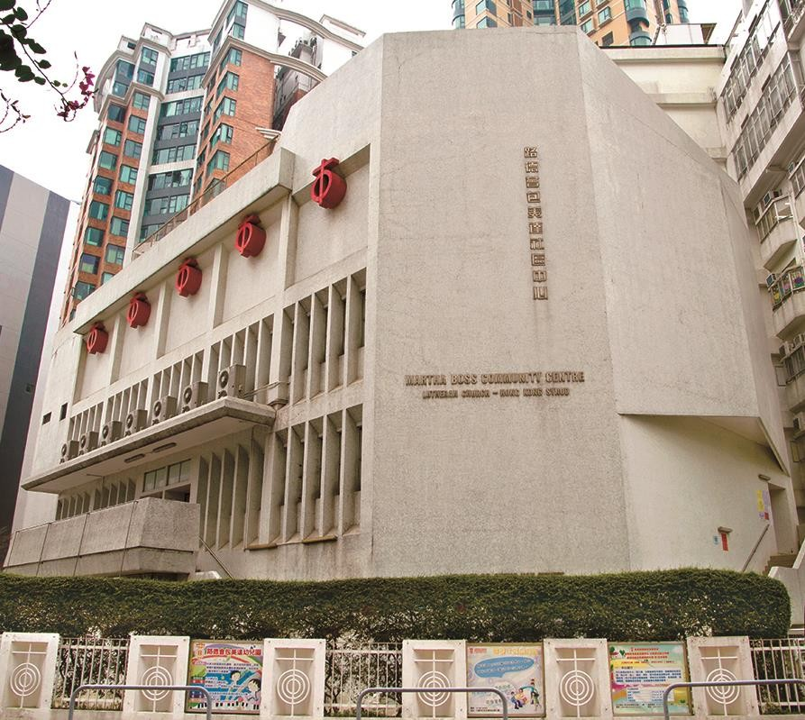
Organiser - HKLSS
Hong Kong Lutheran Social Service, LC-HKS has been established since 1977, by reflecting Christian attitude of social justice through appropriate action. HKLSS provides versatile facilities and services for people with different needs, including nurseries, children and family services, foster care services, counselling services, community development, rehabilitation services, elderly centre, day care centres for the elderly, elderly home. At present, we have more than 60 service units all over Hong Kong.

Slide 8
How it works?
HKLSS as the programme organisor, invites companies in the Hong Kong Science and Technology Park (HKSPT) to provide 2- month internship placements for the students in summer holiday (July – August). HKLSS will also help to arrange the application and screening process, monitor the execution of the programme, to make sure the objectives are achieved.

Slide 9
Who? – Internship Placement Company
Prospect and vision
Companies with growth potential and willing to recruit rigorous youngster to join their company are preferred. The company is expected to provide meaningful work experience to the interns while offering supervision to guide and train them.
Business nature
Companies that develop a variety of products or services will be selected to provide a diversified prospect to attract students studying differenct majors.
Company size
Preferred company size will be having less than 100 employees. The company should be in the growing stage that trying to expand their business in terms of location and variety of products or services.

Slide 10
Who? - Higher Education Students
Higher Education Students who are eagerly looking for
opportunities to broaden their horizons, step out of their comfort zones and earn hands-on working experience are targeted.
Students will be selected and assigned to companies in different industry according to their interests and professions. In the programme, student will experience development, responsibility and a future full of opportunities. They will also gain insight into life at work, while developing practical on-the-job experience.

Slide 11
Programme Content

Slide 12
Programme Content
Vacancy : 10
Internship
Placement
Two-Months Full-time Internship
Reflective Essay
Students are required to submit a reflective essay (not less than 500 words) addressing the lessons they have learned and sharing their improvements after the placement.
Sharing Session
Sharing Session will be held to celebrate and share interns’ achievements in successfully completing the programme.
Transportation and Meal Allowance
Transportation and meal allowance of HK$6,000 , will be granted to students who completed all of the programme contents.

Slide 13
Outstanding Performance Certificate
Outstanding students will be selected to receive the certificate, with reference from the supervisors’ comments and quality of the reflective essay.

Slide 14
Programme Timeline

Slide 15
Programme Timeline
 | Description of Work | Start and End Dates
Phase One | 1. Recruitment Application Interview Result Announcement | Application deadline: 15 April 2022 Interview: Early June 2022 Announcement: Mid June 2022
Phase Two | 2.1 Two-Months Full-time Internship (9am – 6pm, Monday to Friday) | 4 July – 26 August 2022
Phase Three | 3.1 Reflective Essay Submission | 9 September 2022
 | 3.2 Outstanding Performance Certificate Outstanding students will be selected | October 2022
 | 3.3 Sharing Session Students will share their internship experiences and stories | November 2022

Slide 16
Enquiry
HONG KONG LUTHERAN SOCIAL SERVICE
Tel ：2711 9131 | Fax ：2761 9751
Address：89 Chung Hau Street, Homantin, Kln.
Email ：info@hklss.hk
Website ：http://hklss.hk
FB ：https://www.facebook.com/hkLutheranSocialService

